Slide 1


气温预测
Temperature forecast
牛亚翔、刘迦南、
汤鸿博、张颖、游瑞丰

Slide 2
CONTENTS
01
小组分工
02
网页后端
牛亚翔
03
算法后端
游瑞丰
04
数据传输
张颖
05
网页前端
汤鸿博
06
网页前端
刘迦南

Slide 3
Allocation of Task
01
小组具体分工

Slide 4
小组分工
开心连连看
Happy LinkGame
程雨桐：leisuremode，连连看核心算法
张颖：划线，ppt制作，说明文档写作
游瑞丰：排行榜，应用界面
汤鸿博：levelmode，basicmode
陈付鑫：basicmode，背景音乐

Slide 5
Core Algorithm
02
游瑞丰
mainwindow.cpp
game.cpp
helpdialog.cpp

Slide 6
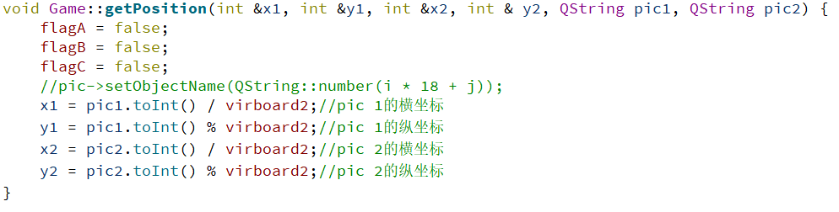
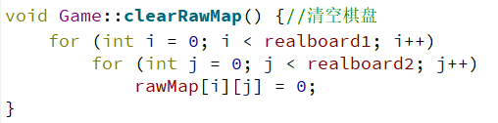
开心连连看
Happy LinkGame
obtain the horizontal and vertical coordinates of the two patterns on the chessboard.
clear the chessboard

Slide 7

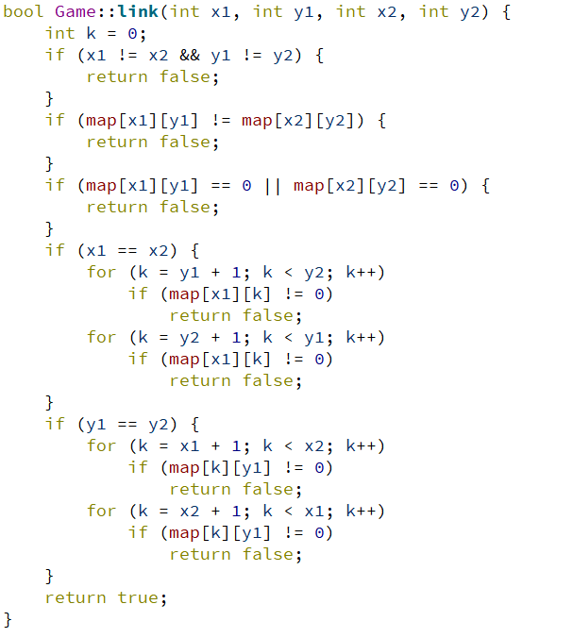
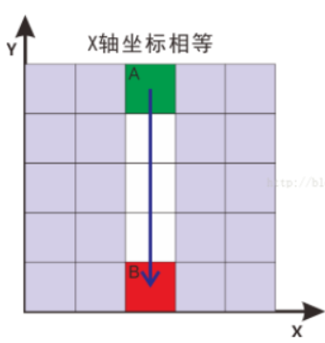
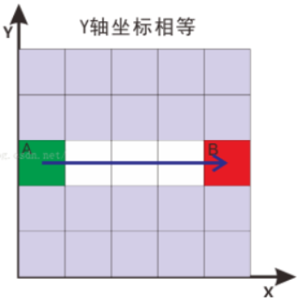
开心连连看
Happy LinkGame
Algorithm: judge whether two patterns can be connected directly, that is, they can be connected without corners.

Slide 8
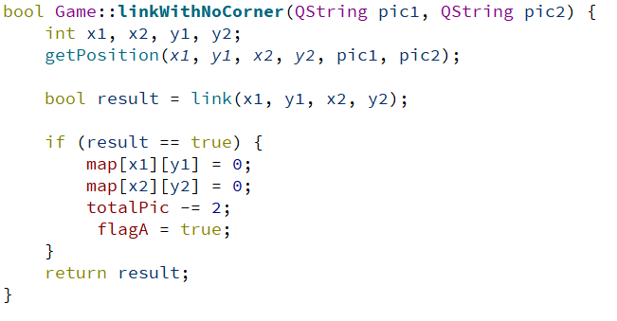
开心连连看
Happy LinkGame

Slide 9
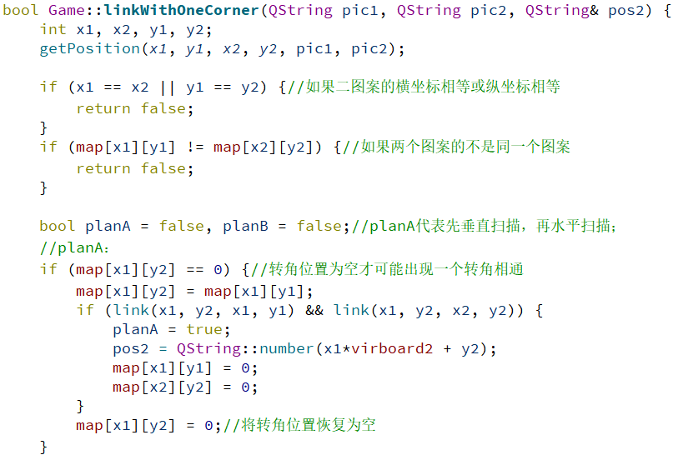
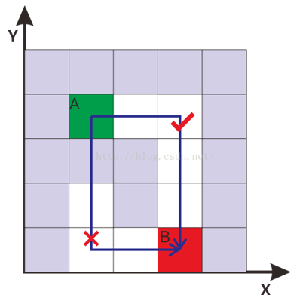
开心连连看
Happy LinkGame
Algorithm: determine whether two patterns can be connected through a corner.

Slide 10
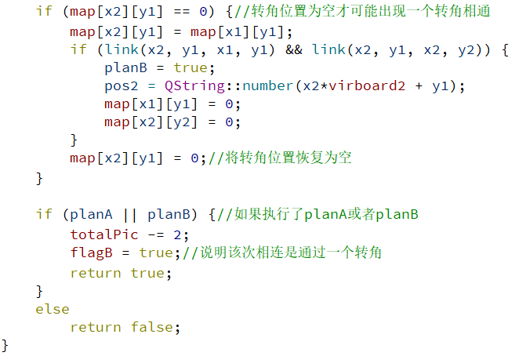
开心连连看
Happy LinkGame

Slide 11
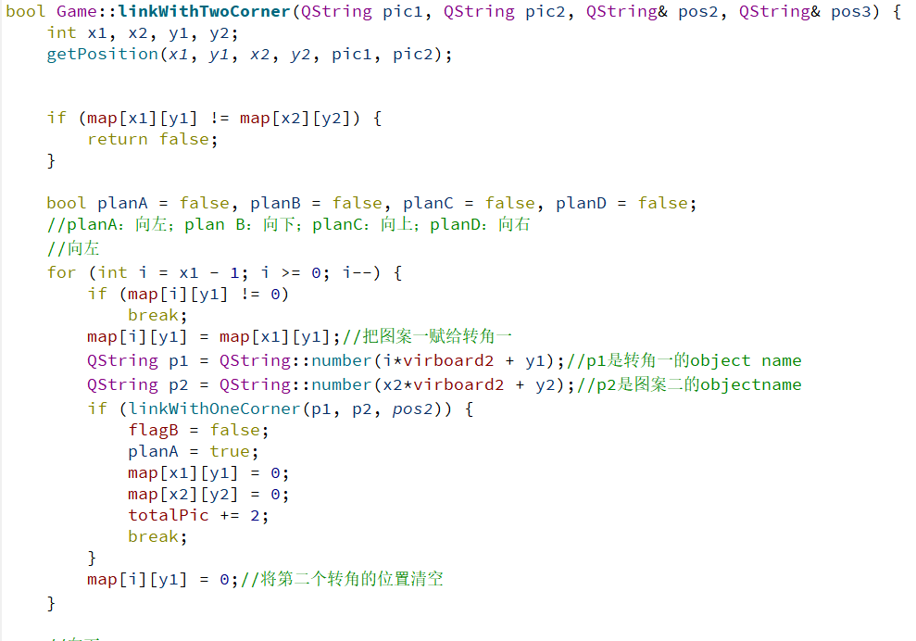
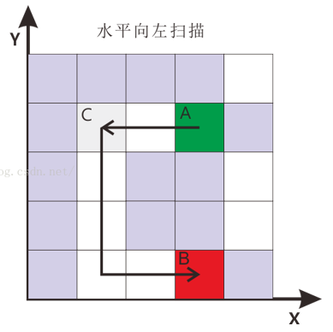
Algorithm: judge whether two patterns can be connected through two corners

Slide 12
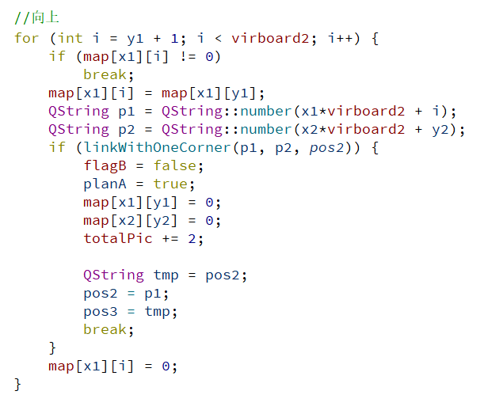
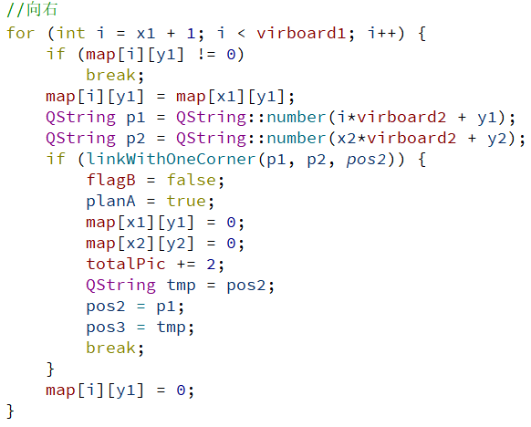
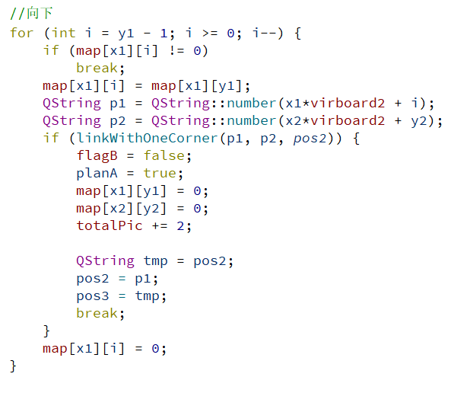
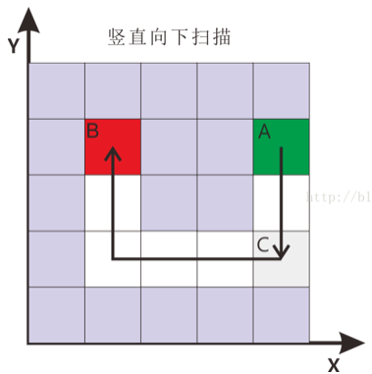
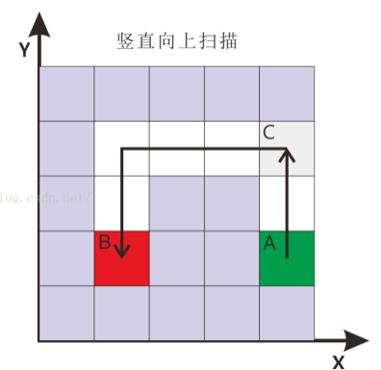
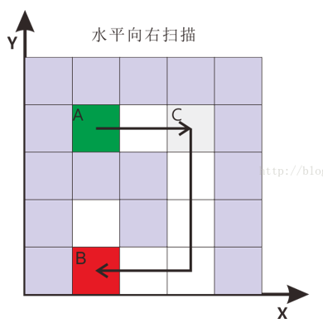

Slide 13
Ranking list
& Connecting line
03
张颖
DrawLineLayer.cpp
Dao.cpp

Slide 14
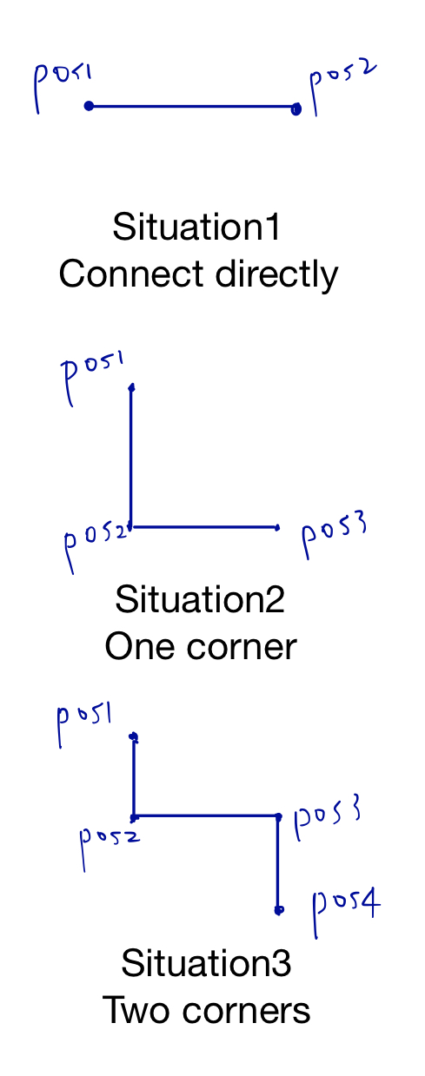
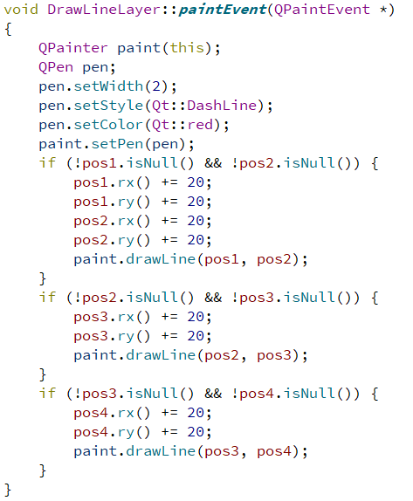
Connecting line
连线算法

Slide 15
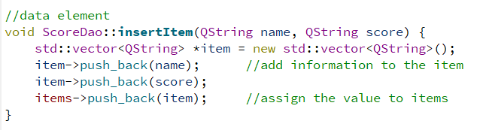
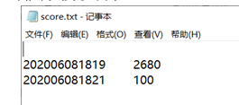
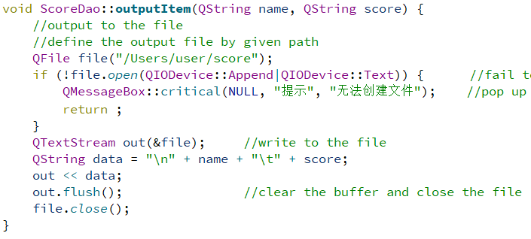
Ranking list
排行榜
Output the ranking list to the file in particular format.

Slide 16
Basic mode window
04
陈付鑫

Slide 17
BasicModeWindow():
The constructor is mainly used to set the basic modes’ layout.
这个构造器主要用于这个游戏界面的一些基本组件的布局
初始界面如上图所示

Slide 18
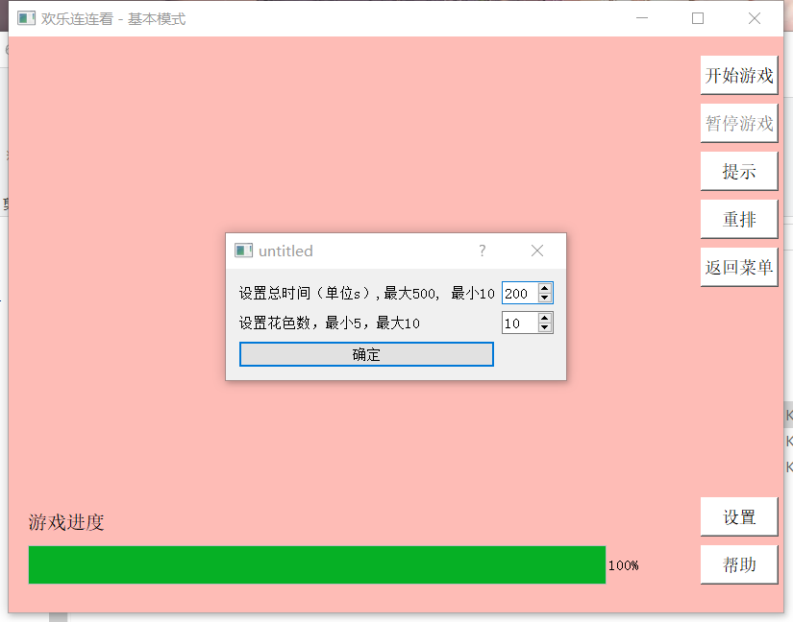
Void showHeip():
Call helpDialog class to show the game’s help.
调用helpDialog类，展示游戏的帮助。
设置功能如上图所示

Slide 19
Void showHeip():
Call helpDialog class to show the game’s help.
调用helpDialog类，展示游戏的帮助。
Void changeSpeed():
Create a setting dialog ,which can be used to set game’s difficulty,such as changing pictures’ species and calling _changSpeed() function to modify the total time of the game.
生成一个设置的对话框，可以用于设置游戏的难度，如改变图片的种类和游戏的总时长，并调用_changSpeed()函数进行修改。
Void _changeSpeed():
According to the result of above dialog ,modify the value of speed and PIC_NUM.
根据上述对话框中的结果，修改speed和PIC_NUM的值。

Slide 20
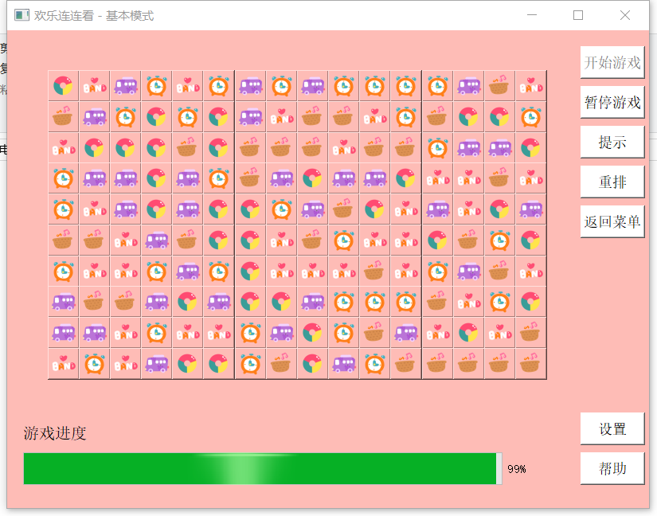
Void startGame():
Call the initMap() function to initialize the map and reset the game time.
调用initMap()函数初始化地图，并重置游戏时间。
Void restartGame():
Call clear() function to clear the map,then call the restartGame() to restart the game.
调用clear()函数清空棋盘，再调用restartGame()来重新游戏。
Void reset():
Reset all the picture and the deleted picture will not be displayed.
重排所有图片，并将已删除的图片不再显示。
Void resetMap():
Call clear() function to clear the map and reset() function to reset the map.
调用clear()函数清空棋盘，再调用reset()函数重排整个棋盘。
游戏界面如上图所示

Slide 21
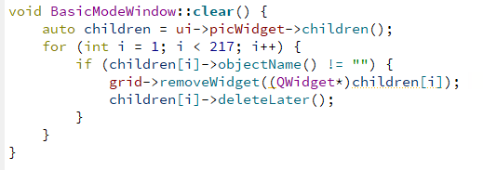
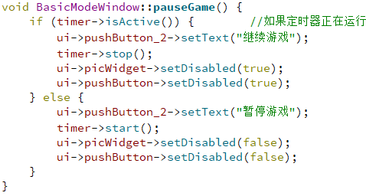
Void clear():
Delete all the picture buttons to clear the map.
删除所有图片按钮来清空棋盘。
If the timer is active ,let it stop;if not , let it continue.
如果计时器正在计时，则令其停止，不在计时，则令其继续计时

Slide 22
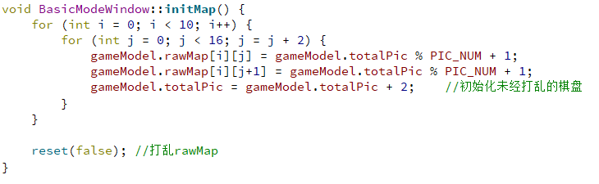
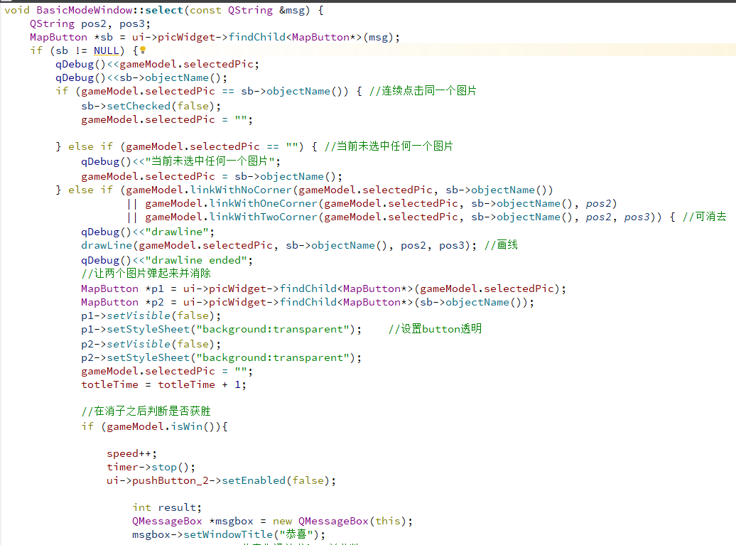
Void initMap():
Give array rawMap value on behalf of the relevant picture. Then call reset() function to reset the pictures randomly.
给数组rawMap赋值，用于代表该元素代表的图片。之后调用reset()将这些图片打乱.
Void select():
when the picture is clicked, if there is no picture being clicked before ,let it hollow.
当图片被点击时，若之前没有图片被点击，就让这个图片陷下去。
If it has been clicked and the two picture can’t be deleted,let two bounce.
若之前被点击过，如果这两个图片不能消去，则让这两个图片弹起。
If it has been clicked and the two picture can be deleted,delete the two and judge the game’s victory.
若这两个图片可以消去，则消去这两个图片并判断游戏是否胜利。

Slide 23
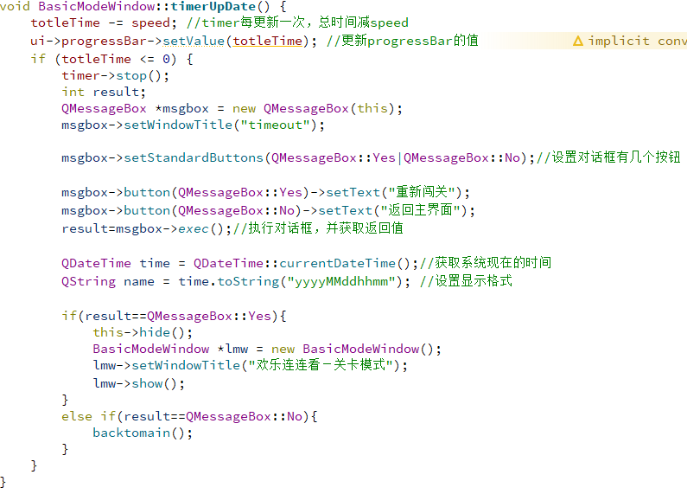
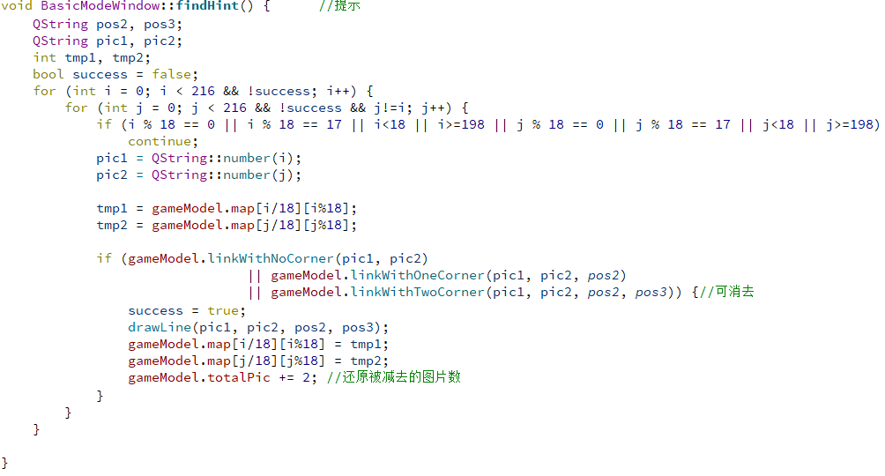
Void timerUpDate():
When timer is updated , the game time will be lessened , game will not be over until the game time runs out.
计时器每更新一次，游戏时间都会减少，当游戏时间耗尽时游戏结束。
Void findHint():
Traverse all the not deleted picture’s two combinations to find a correct plan and draw line to remind the player.
遍历所有未被消去的图片的两两组合，找到一个可行解，并用线标出用于提示玩家。

Slide 24
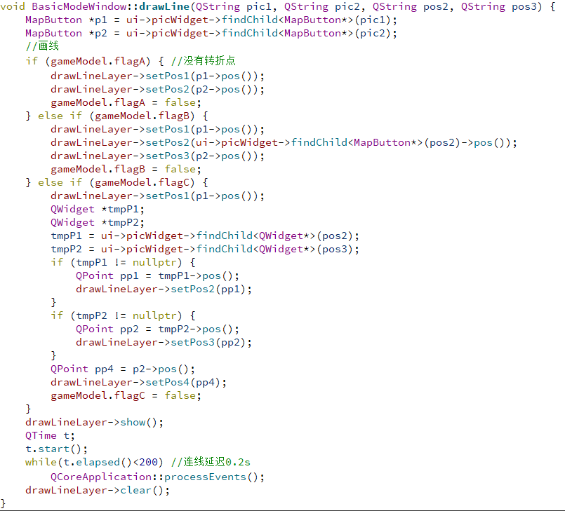
Void drawLine():
Judge the line’s species and draw them.
判断连线的类型，并将其画出。

Slide 25
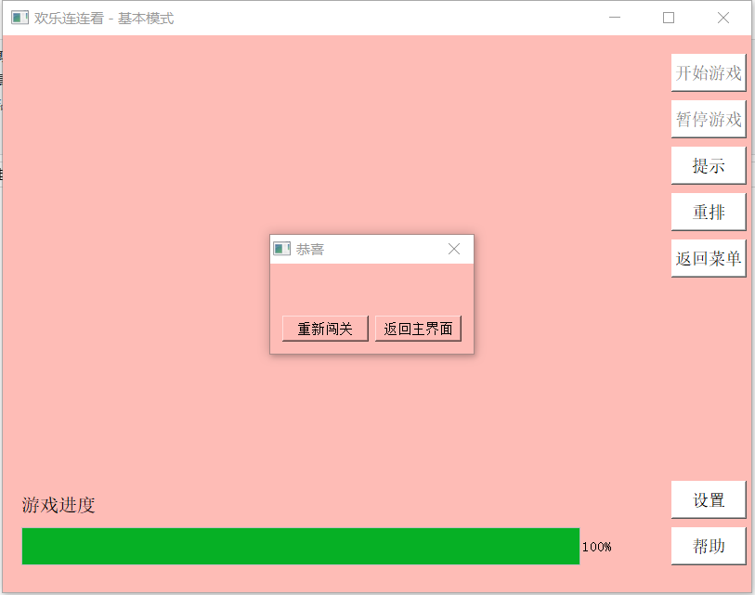
通关界面如上图所示

Slide 26
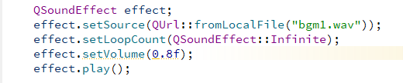
P.S.
Bgm part:
Use the QsoundEffect to display the background music.
使用QSoundEffect来播放背景音乐。

Slide 27
Leisure mode window
05
程雨桐

Slide 28
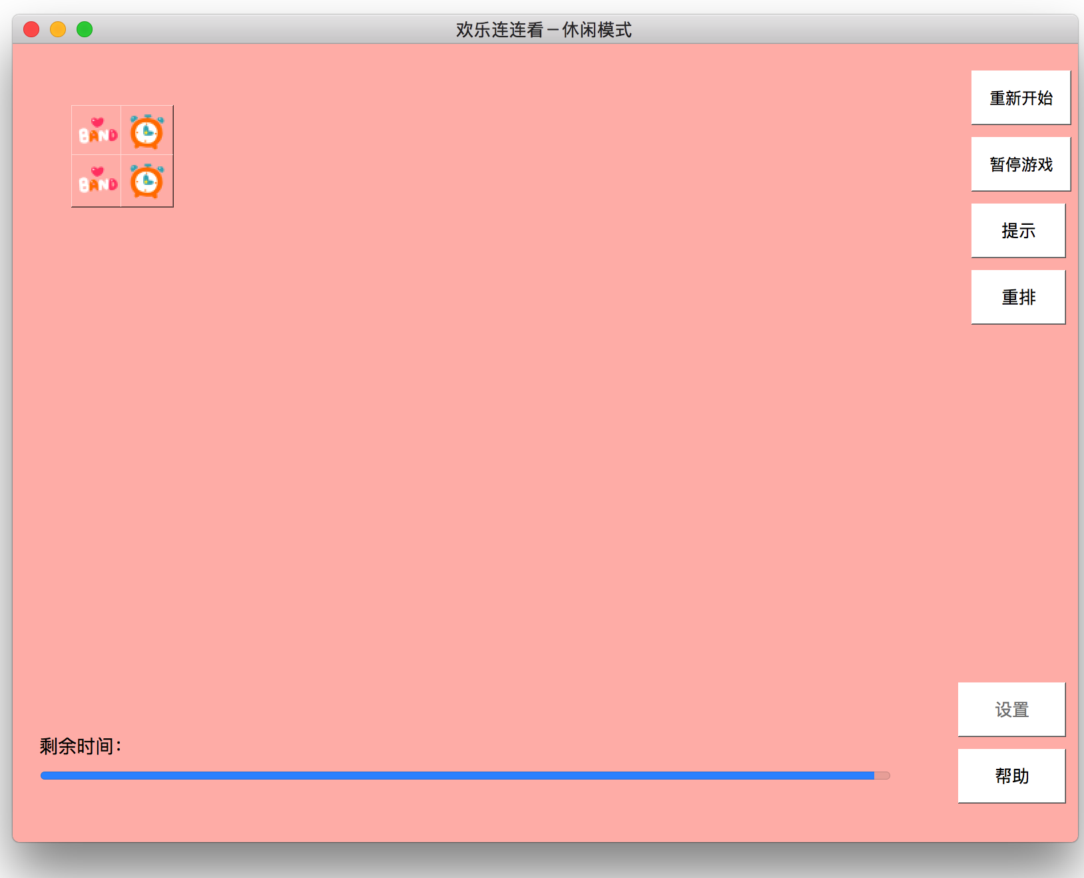

Slide 29
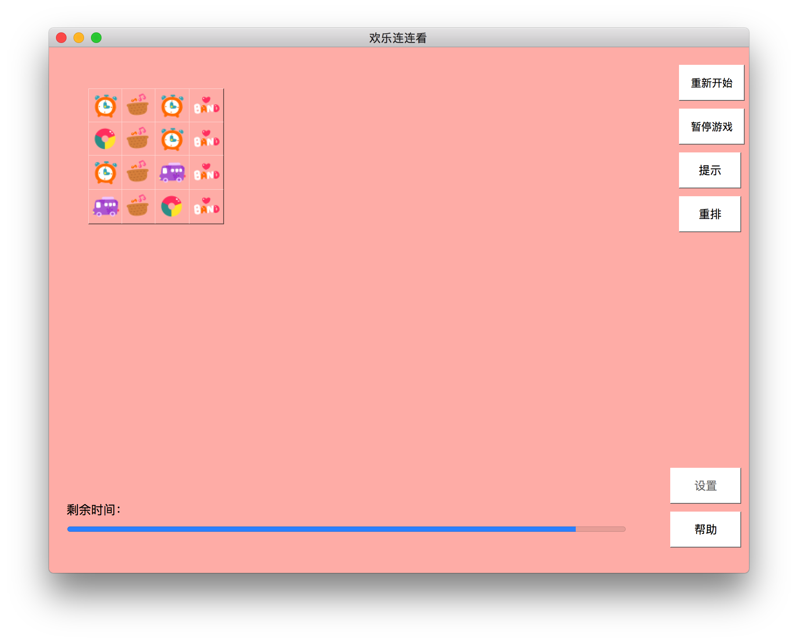

Slide 30
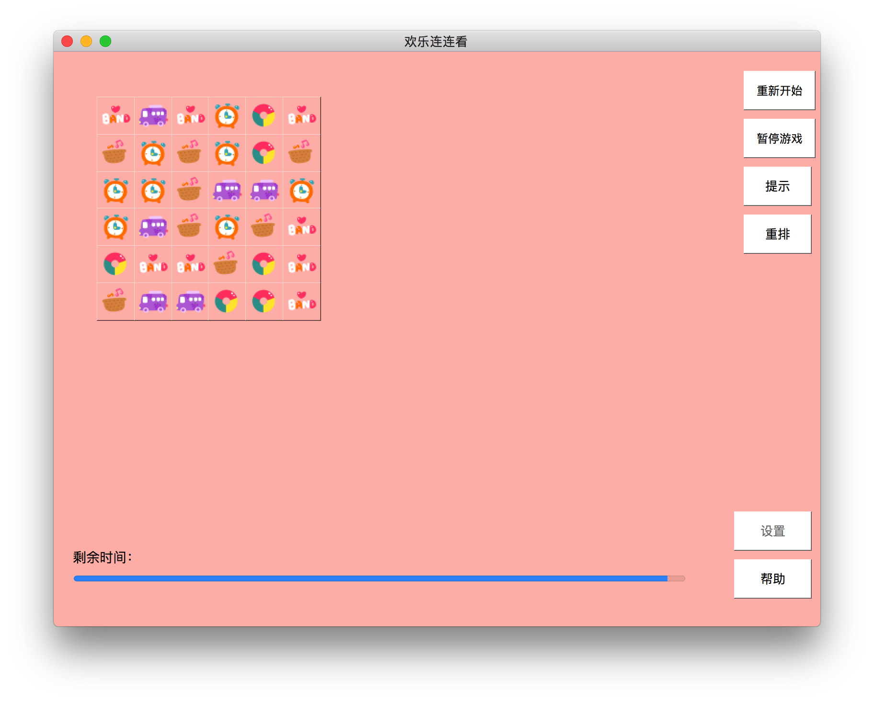

Slide 31
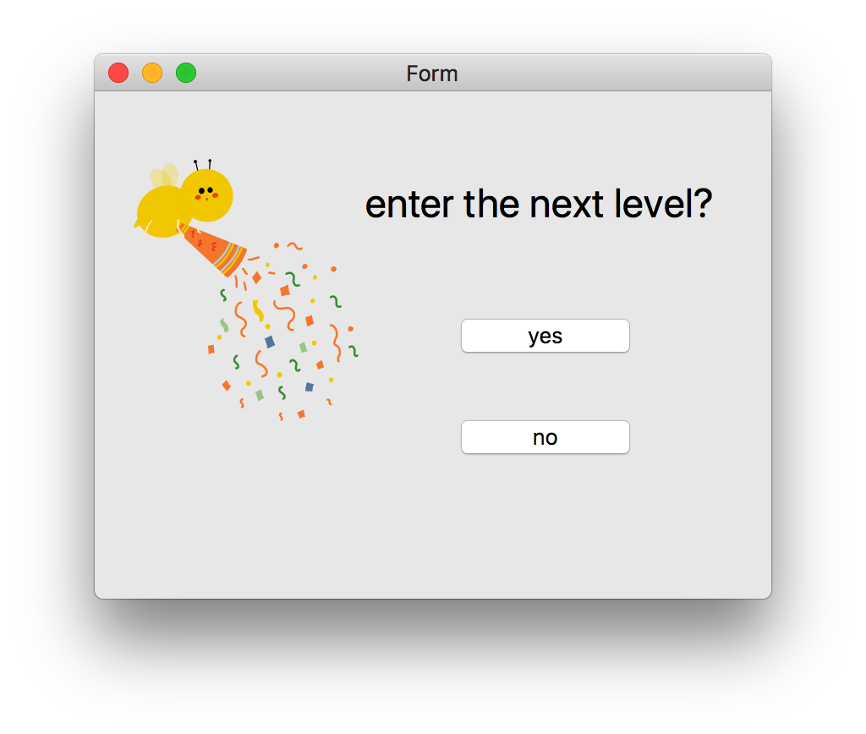

Slide 32
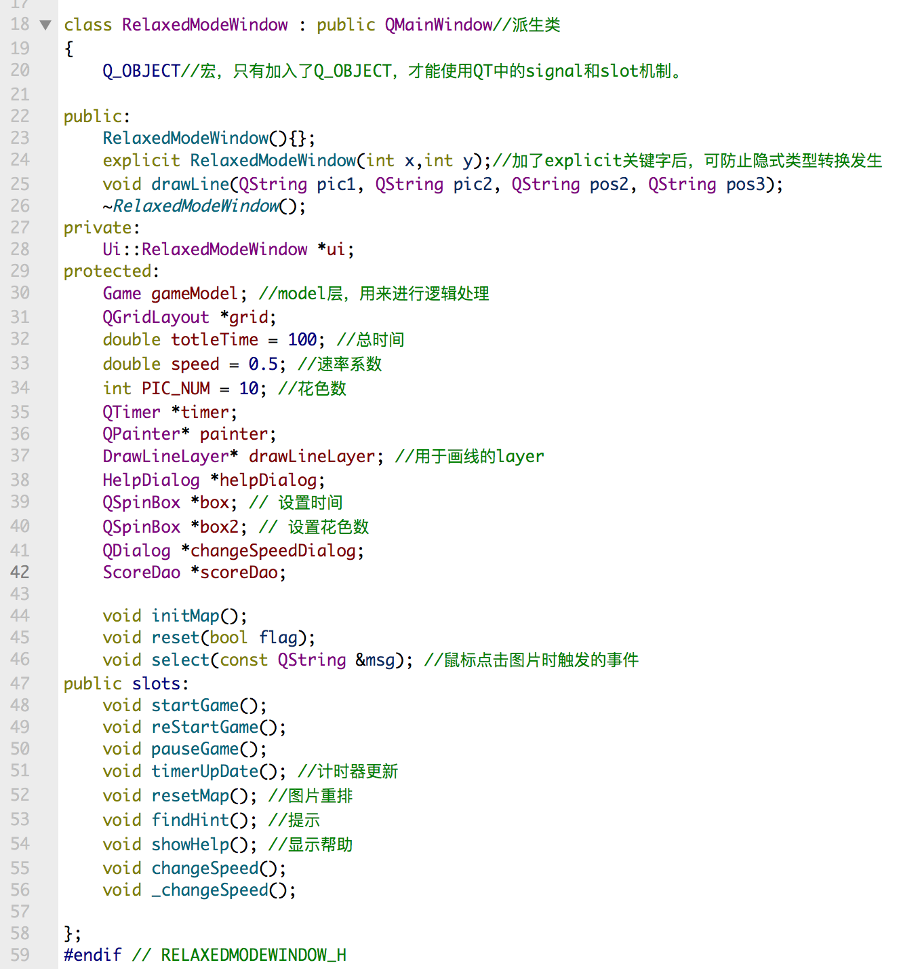
RelaxModeWindow.h

Slide 33
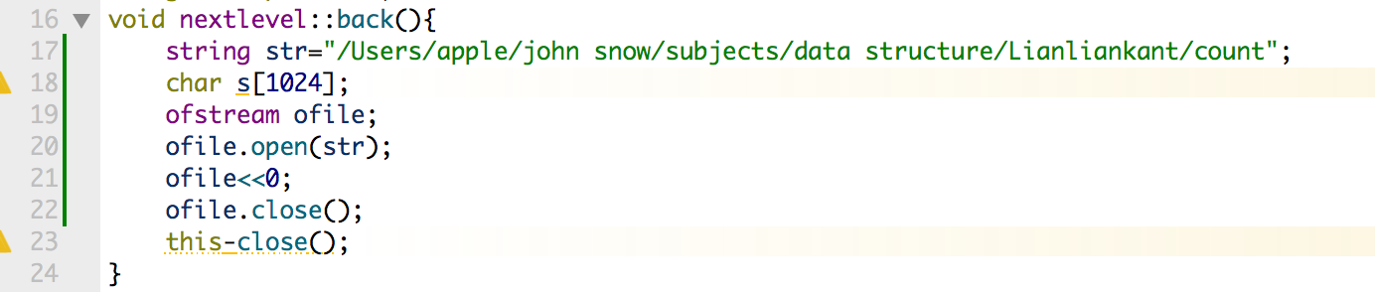
返回首页return to the starting interface
Starting interface is when the board is the original size(2*2), so , we write 0 into the count file.

Slide 34
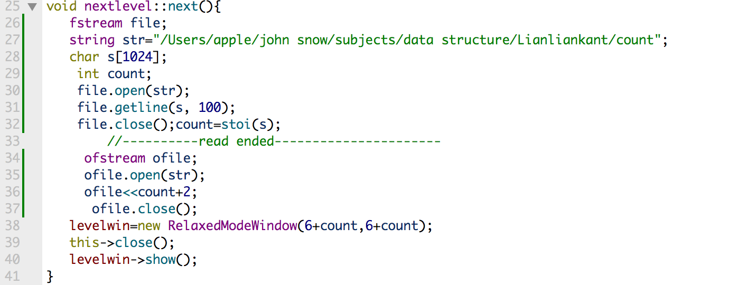
下一个关卡 enter next level
What differ each level is the board size, when you enter a higher level, the board width extend by 2 units and the length extend by 2 units also.as a result, we read the count file every time we enter the next level, and add 2 to whatever we read.

Slide 35
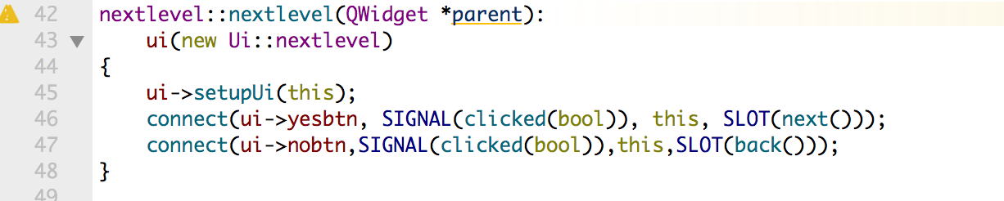
下个关卡界面 interface of next level
What differ each level is the board size, when you enter a higher level, the board width extend by 2 units and the length extend by 2 units also.as a result, we read the count file every time we enter the next level, and add 2 to whatever we read.

Slide 36
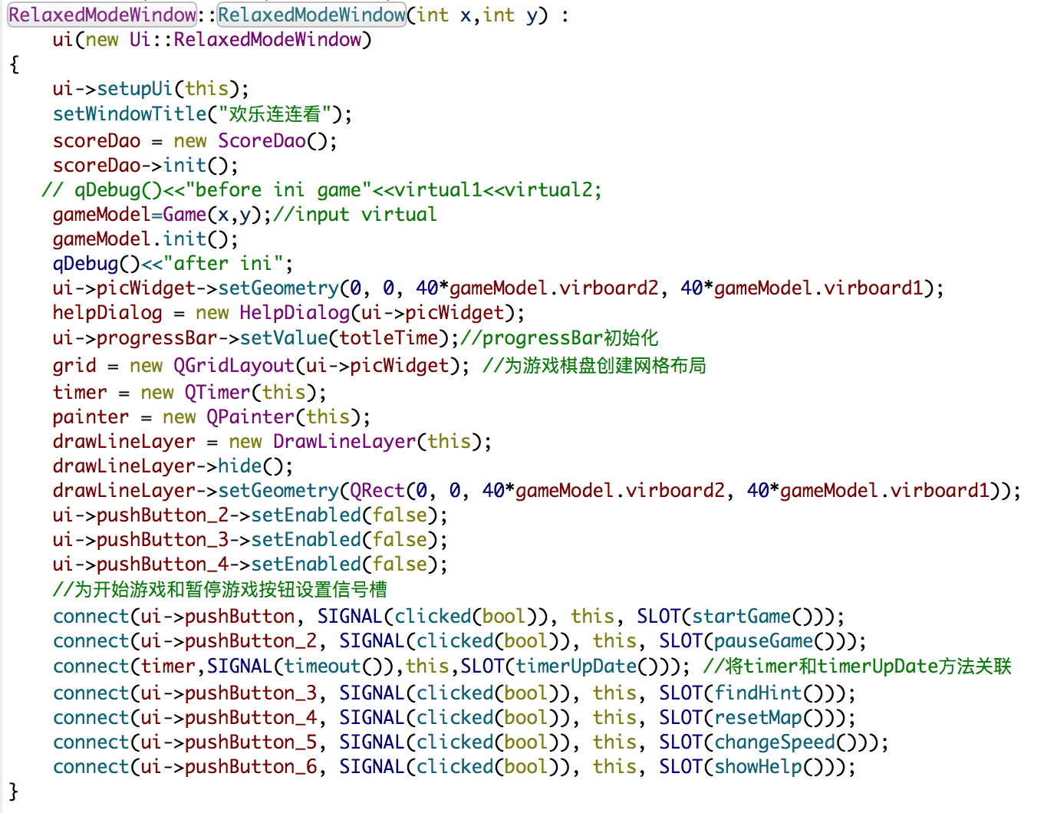
休闲模式界面 interface of the leisure mode

Slide 37
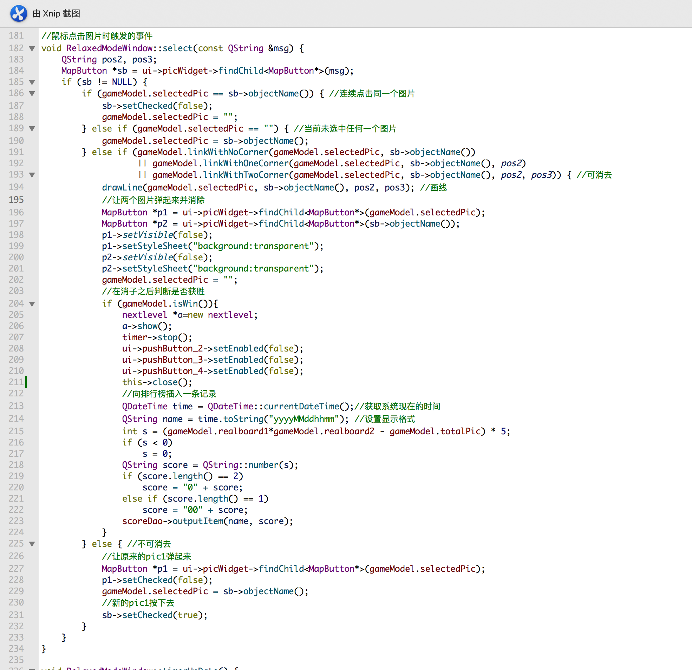
选择方块 select the cube
There are two variables, one is the foreselect, recoding the cube you select earlier; another is the curselect, recoding the cube you select.when you select a cube for the first time,the foreselect is null, and the curselect is whatever you select; and when you choose a second cube, the earlier curselect become foreselect, and whatever you select now become curselect, if the curselect and foreselect can be canceled, then cancel them, else do nothing

Slide 38
Level mode window
06
汤鸿博

Slide 39
CONTENTS
01
功能
function
02
核心算法
Core algorithm

Slide 40
Difficulty
功能
Function
3 levels
Picture number
Picture type
Total time

Slide 41
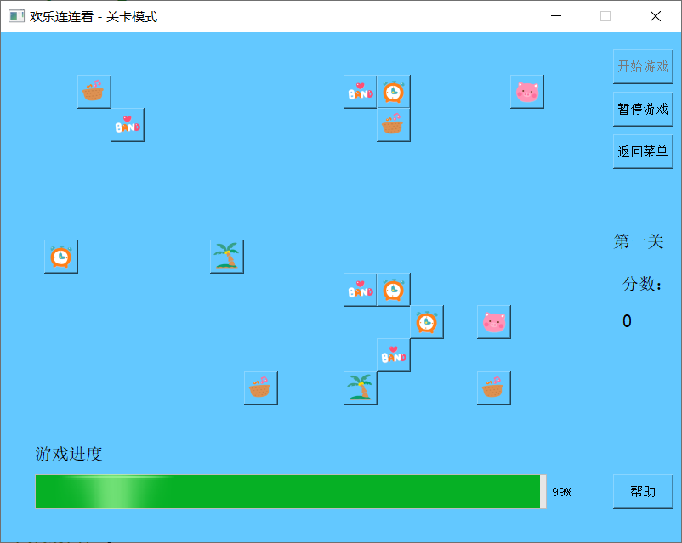
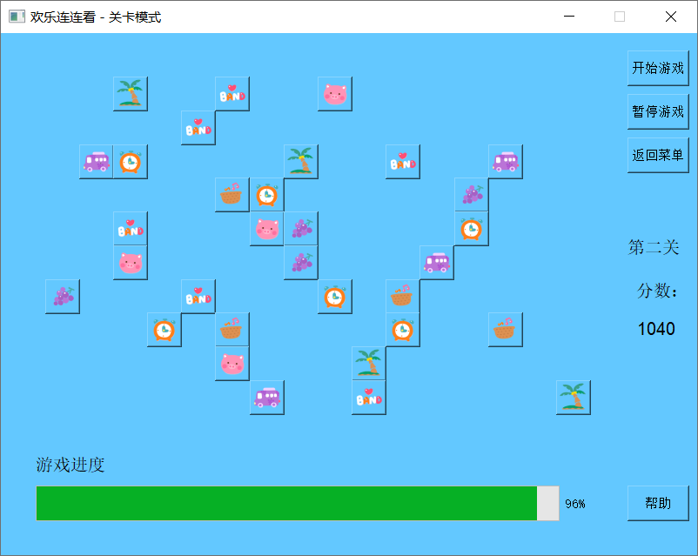
Difficulty
功能
Function

Slide 42
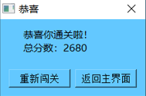
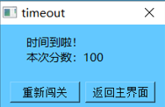
Rule
功能
Function
Success
Failure
Score
Match score：a pair=20
（earn time）
Time score：remaining time×10

Slide 43
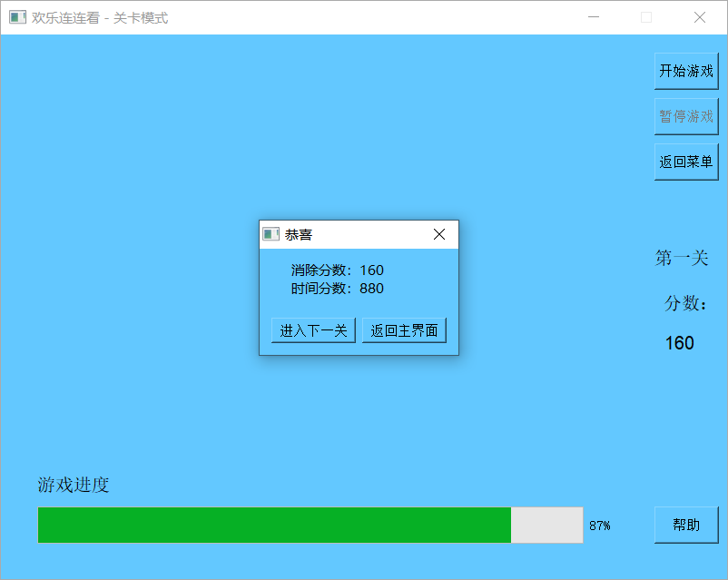
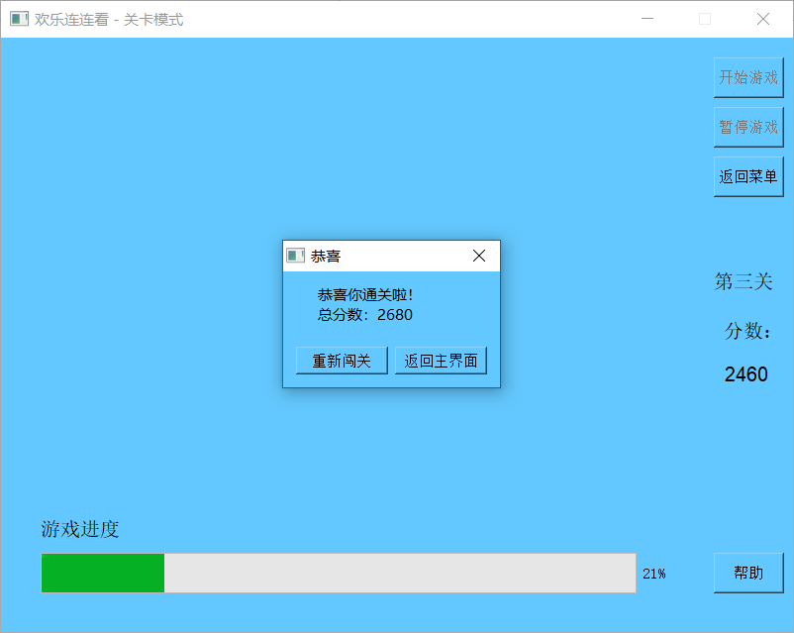
Score
功能
Function

Slide 44
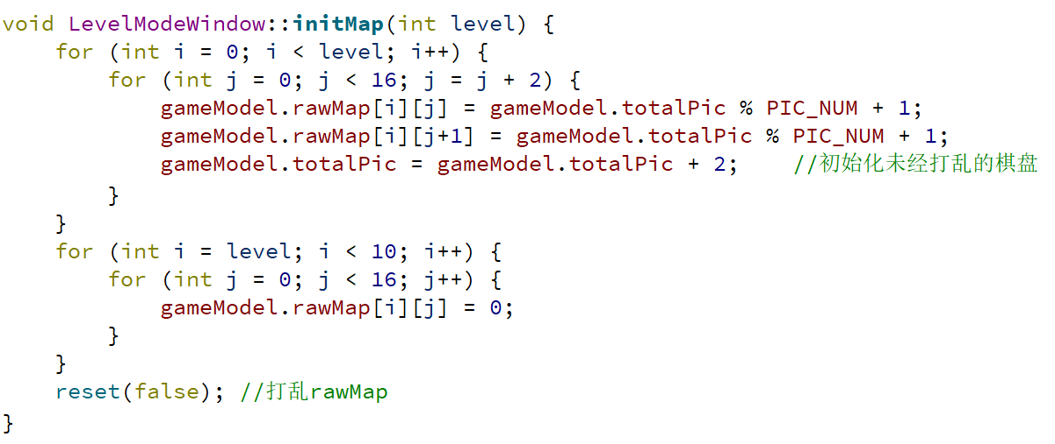
Initmap
核心算法
Core algorithm

Slide 45

Select
核心算法
Core algorithm
When match a pair of pictures

Slide 46

Select
核心算法
Core algorithm
When win the game

Slide 47

Select
核心算法
Core algorithm
When match a pair of pictures
When finish all the level

Slide 48

Select
核心算法
Core algorithm
When finish all the level

Slide 49

Select
核心算法
Core algorithm
When finish one level

Slide 50

Select
核心算法
Core algorithm
Reset automatically
When don’t exist a pair of pictures

Slide 51

Timer update
Core algorithm

Slide 52

Select
Core algorithm
Startgame
Initialize map
Initialize Progressbar
Start timer

Slide 53
Thank You for Watching!

